Slide 1
The Joe Rogan
Podcast Logger
A CRUD Application by Ivan Okpomor

Slide 2

Brief
Create a CRUD application with the utilisation of supporting tools, methodologies and technologies that encapsulate all core modules covered in training

Slide 3


The Project
As an avid listener/watcher/supporter of the Joe Rogan Experience i thought it would be interesting to create a website that logs podcast episodes and saves them to a database.
As the knowledge and conversations that take place in tese 3 hour segments of entertainment are really worth taking note of
CRUD
With this task, I will be able to hit all aspects of CRUD functionality.
C- creating a podcast object
R - viewing the podcast object in the logger
U -updating the podcast object
D -deleting the podcast object

Slide 4
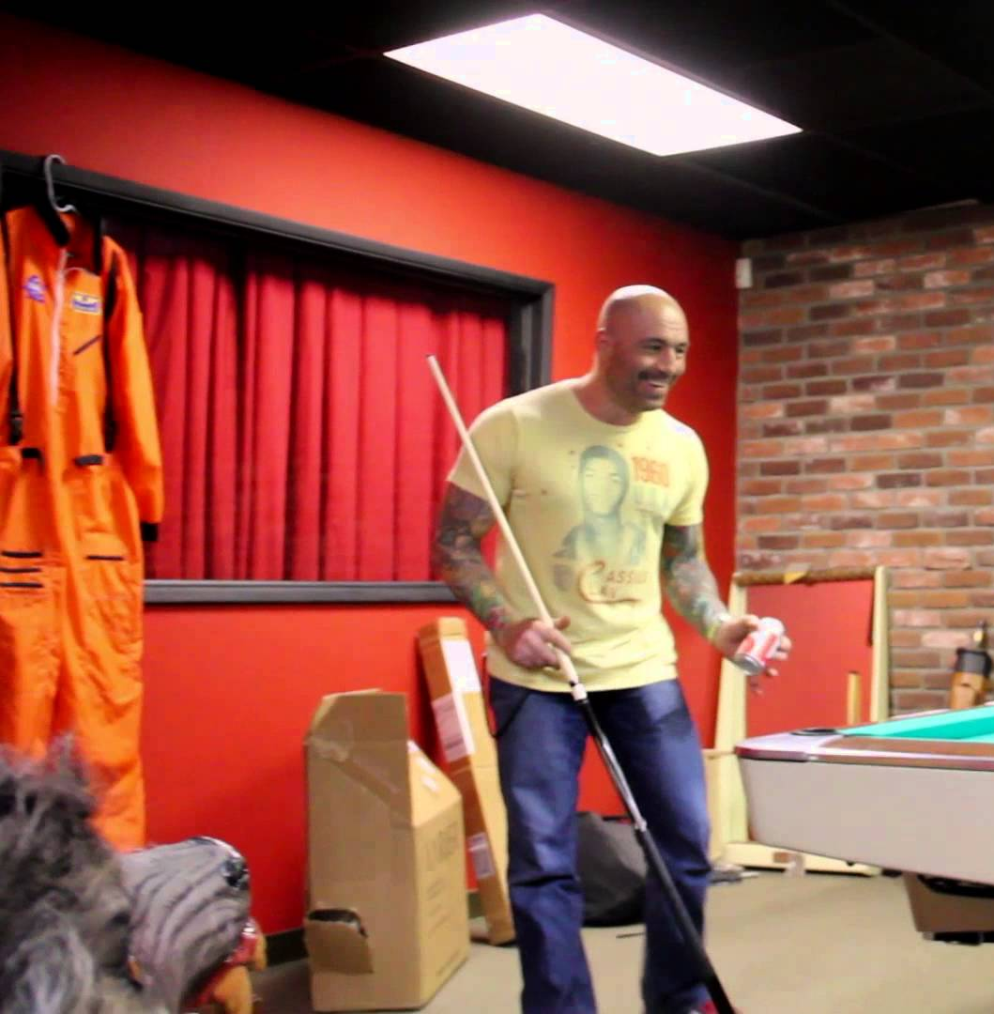

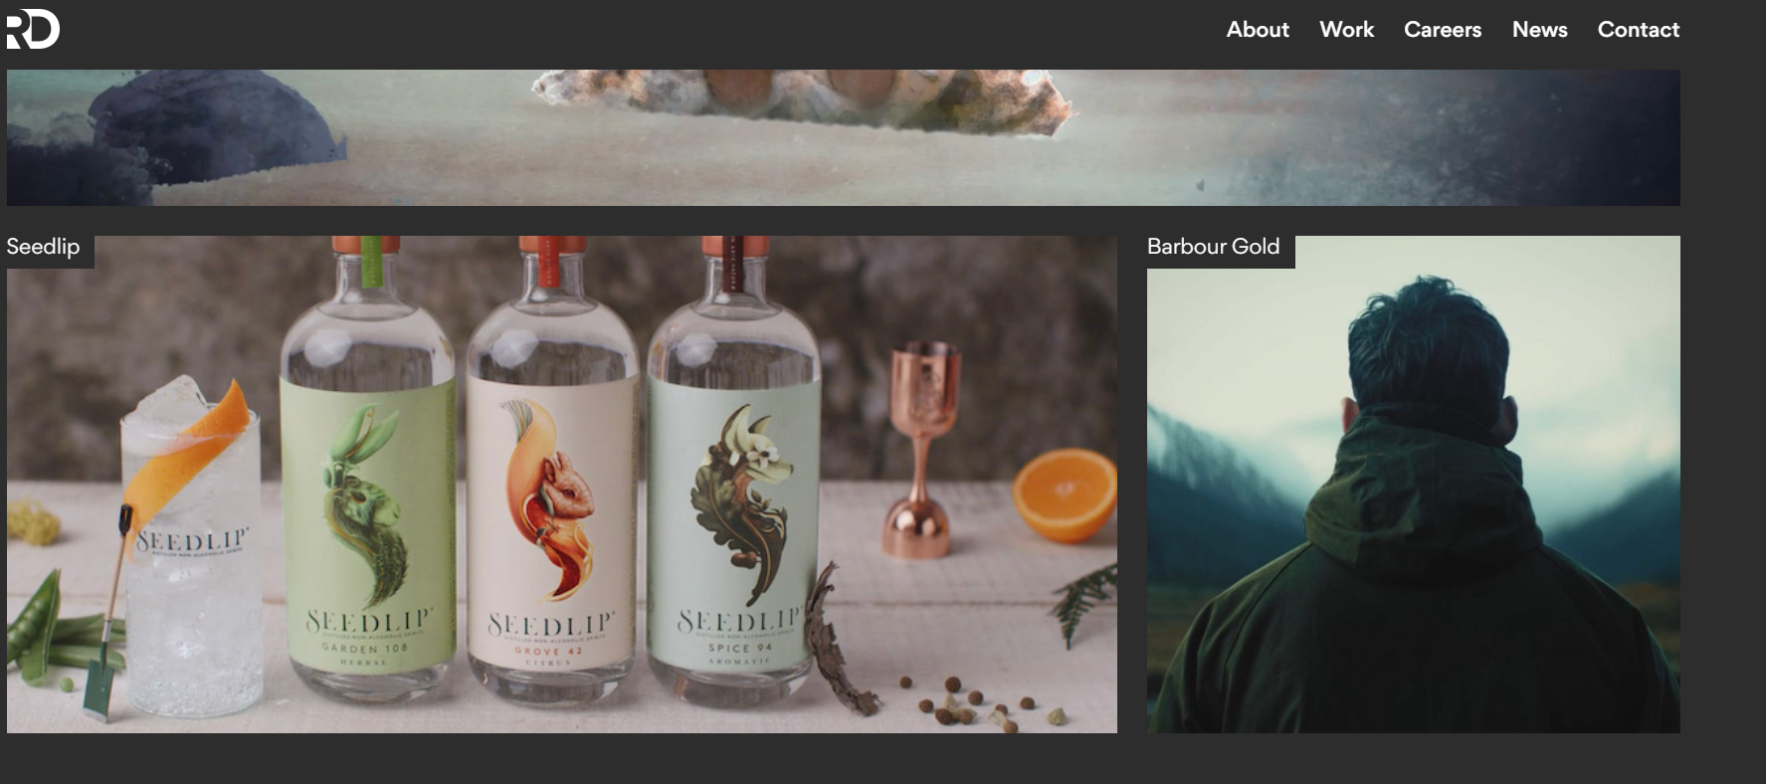
Design planning
I decided to follow the theme from his podcast logo, the set of his podcast and also the aesthetic of a typical comedy club, along with a dark themed web page i’ve seen many design companies utilise.

Slide 5
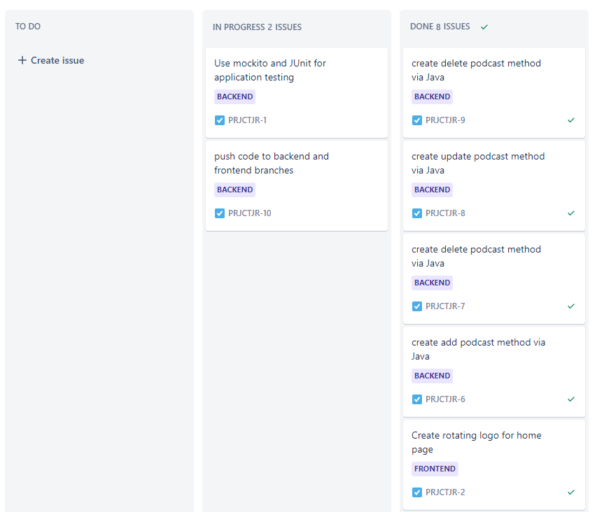
Planning
Kanban Jira Board With this I was able to develop user stories, implement sprints to complete different goals along with my project.

Slide 6
Technology Implemented
.
Version Control GitHub
Database My SQL WorkBench (h2 database for testing)
Backend Java
Frontend
HTML, Javascript, CSS, Bootstrap

Slide 7
Testing
.
Integration Testing
Unit Testing
: JUnit, MockMVC, Mockito

Slide 8
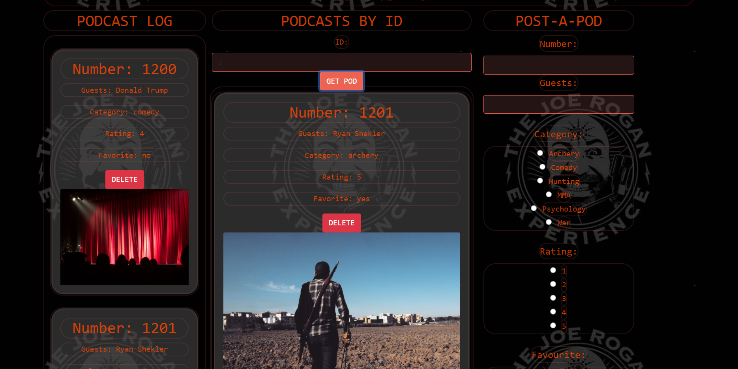
Demo

Slide 9
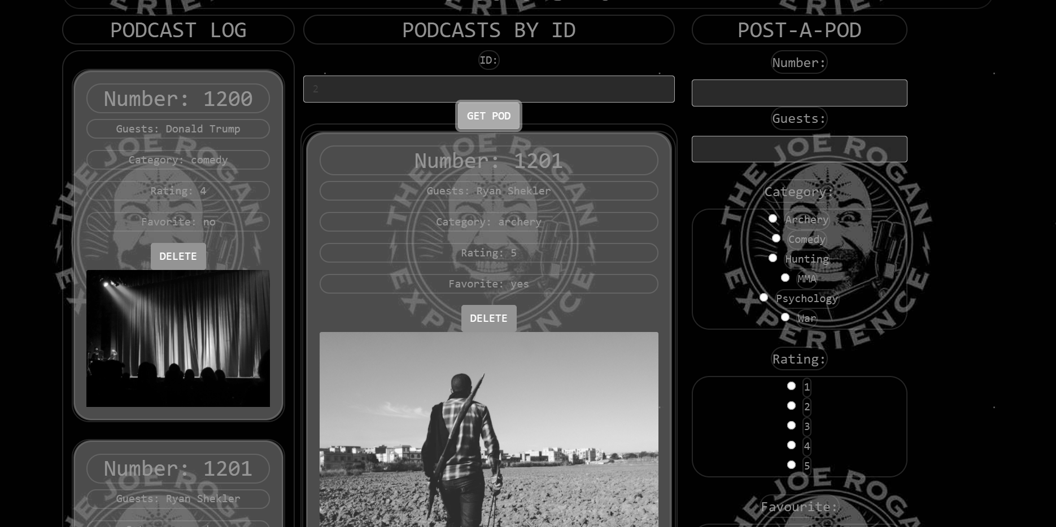
Where will this website go ?
With aims to continue optimising this websites CRUD functionality there are a few striking opportunities i would like to implement:
A Favourites tab, highlighting the users favourite podcasts
A watch later tab, where users can save podcasts they wish to view at some point
A Top Guests tab, where users can see who there most watched guests are and find related work from these individuals
A Top Categories tab, so users can find out what their favourite topics and interests are

